Slide 1
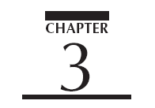



Slide 2
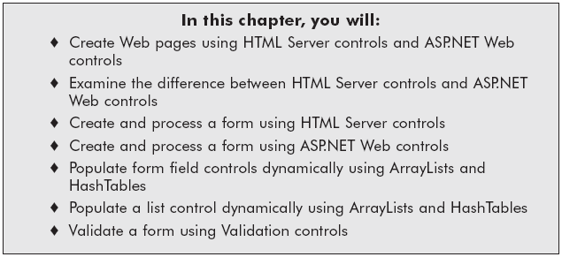
Chapter Objectives

Slide 3
Using HTML Server Controls
All HTML tags can be changed into server-side tags using runat=”server”
  limited functionality compared to Web controls
  provide output similar to HTML counterparts
New properties now available
  Visible property - Boolean value that indicates whether a Server control is rendered as an HTML control on the page

Slide 4
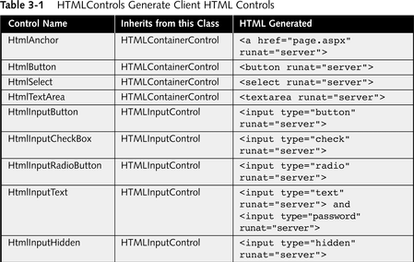
HTML Server Controls

Slide 5
HTML Control
Client-Side Event Handlers
Client-side controls have events such as onClick and onChange are associated with HTML client controls
When HTMLServer control value has changed the OnServerChange or OnServerClick event occurs

Slide 6
Splitting Lines of Code and
Concatentation of Code
Note:
  You can use concatenation character (&) or (+) to append strings
  You can use the line termination character (_) to continue the code across multiple lines
  The  character is used in the book to provide you with emphasis that the line of code is split in the book, but you should not split the line of code in your application

Slide 7
HTML Server Control
Server-side Event Handlers
HTML controls that support the OnServerChange event:
  HTMLInputCheckBox
  HTMLInputRadio
  HTMLInputHidden
  HTMLInputText
  HTMLTextArea
  HTMLSelect
HTML controls that support the OnServerClick event:
  HTMLInputImage
  HTMLAnchor
  HTMLButton
  HTMLForm

Slide 8
Sample Web Form with
Hidden Input Fields and JavaScript Call
<input name="WebAddress" type="text" id="WebAddress"
onchange="__doPostBack('WebAddress','')"
language="javascript" />
<input type="submit" name="GoBtn" value="Go" id="GoBtn" />
<input type="hidden" name="__EVENTTARGET" value="" />
<input type="hidden" name="__EVENTARGUMENT" value="" />

Slide 9
_doPostBack
JavaScript Event Handler
To be able to detect these events on the server, Visual Studio .NET will create a generic JavaScript event handler called _doPostBack
The event sends back to the server
  eventTarget - name of the control
  eventArgument - arguments
This handler only is required once per page, and is written by the server, not the programmer

Slide 10
doPostBack
JavaScript Event Handler (continued)
  <script language="javascript">
  <!--
  function __doPostBack(eventTarget, eventArgument) {
  var theform = document.ctrl0;
  theform.__EVENTTARGET.value = eventTarget;
  theform.__EVENTARGUMENT.value = eventArgument;
  theform.submit();
  }
  // -->
  </script>

Slide 11
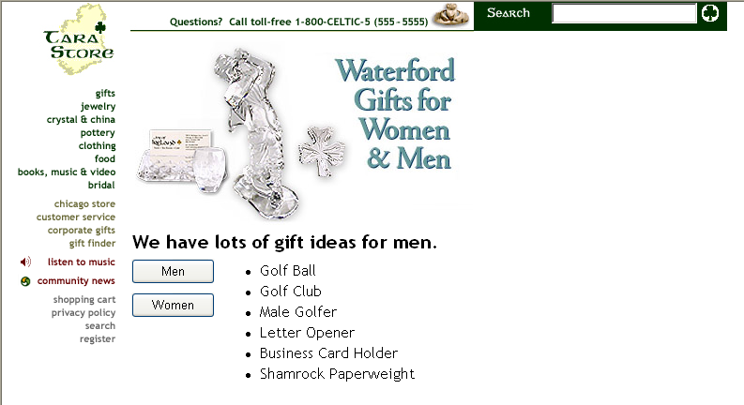
Creating an ASP.NET Page HTMLButton.aspx (Page 93)

Slide 12
HTMLButton.aspx (continued)
Create Chapter3 solution
  Insert HTML server controls
  Change properties
  Dynamically change the contents of the page

Slide 13
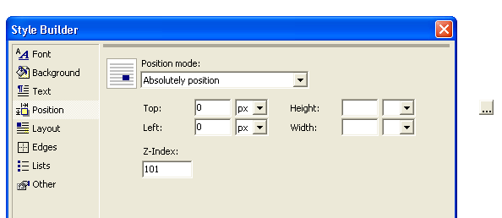
Changing Position Properties in Style Builder

Slide 14
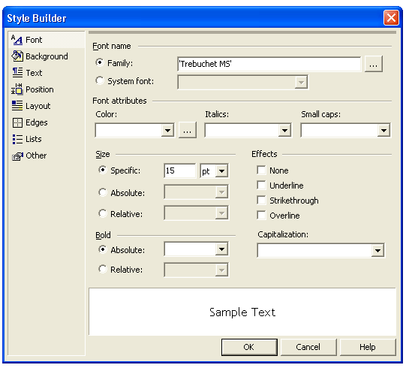
Changing Font Properties in Style Builder

Slide 15
HTMLButton.aspx (continued)
Change the visible property for the two label controls to false
    lblGiftIdeasMen.Visible = False
    lblGiftIdeasWomen.Visible = False

Slide 16
HTMLButton.aspx (PP. 93-98)
Men button – change InnerHtml of the label:
    lblTitle.InnerHtml = _
    "<b>We have lots of gift ideas for men.</b>"
    lblGiftIdeasWomen.Visible = False
    lblGiftIdeasMen.Visible = True
Women button – change InnerHtml of the label:
    lblTitle.InnerHtml = _
    "<b>We have lots of gift ideas for women.</b>"
    lblGiftIdeasWomen.Visible = True
    lblGiftIdeasMen.Visible = False

Slide 17
HTML Image Button and Label
Server Controls
Properties of individual controls can be changed through Properties window
You can also change properties of individual controls by adding your code to code behind the page
You can change the property when page loads, or when an event occurs, such as a button click
Properties are not always the same for HTML server controls and ASP.NET server controls

Slide 18
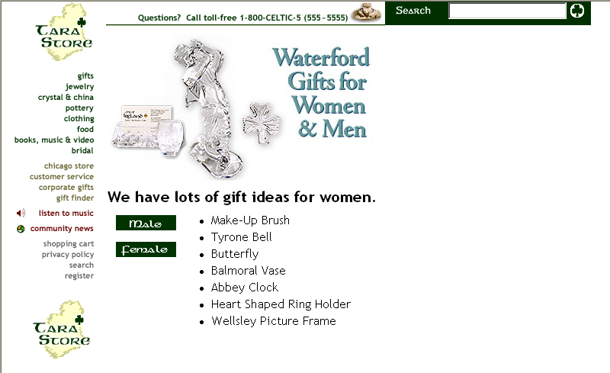
HTML Image Button and
Label Server Controls
HTMLImageButton.aspx

Slide 19
HTMLImageButton.aspx (PP. 98-100)
The btnMale_ServerClick event handler
  Private Sub btnMale_ServerClick(ByVal sender As System.Object, ByVal e As System.Web.UI.ImageClickEventArgs)
  Handles btnMale.ServerClick
    lblTitle.InnerHtml = _
    "<b>We have lots of gift ideas for men.</b>"
    lblGiftIdeasWomen.Visible = False
    lblGiftIdeasMen.Visible = True
  End Sub

Slide 20
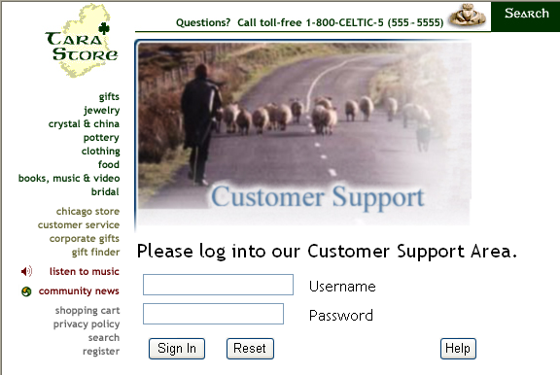
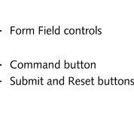
Creating a Form with
HTML Server Controls
HTMLInputButton.aspx

Slide 21
HTMLInputButton.aspx (PP.101-103)
Set InnerHTML and Visible Properties
Retrieve the values from text boxes
  txtUserName.Value
  txtPassword.Value
Buttons:
  Submit, Reset, Command are available
  Can call procedures when clicked

Slide 22
HTML Radio Button, Dropdown List, and Hyperlink Server Controls
Hyperlinks
  Allow you to create links to other pages or to internal targets within the same page
Check boxes, radio buttons, and drop-down lists
  Are form fields that allow you to select from lists of options
  Can retrieve their values using properties of the form control

Slide 23
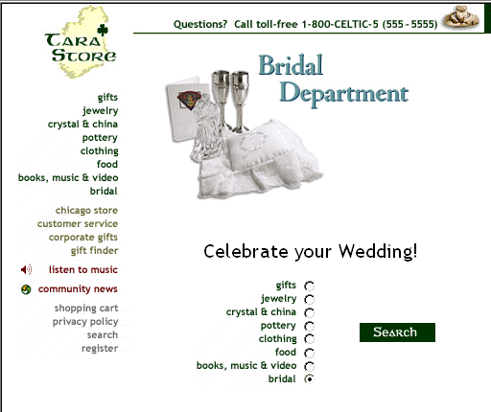
HTMLRadioButton.aspx

Slide 24
HTMLRadioButton.aspx (PP. 103-104)
Determines which radio button is checked
  If (rdBridal.Checked = True) Then
  lblTitle.InnerHtml = "Celebrate your Wedding!"
  imgTop.Src = "images/28.jpg"

Slide 25
Creating a Page with a
Dropdown Server Control
Created with the HTML Select tag
  Option tags create each individual item
  A value can be associated with each item in the list
SelectedIndex property of the drop-down list box
  When nothing has been selected the SelectedIndex property returns the value -1
Add method - add items to the list dynamically when the page loads, or when an event occurs

Slide 26
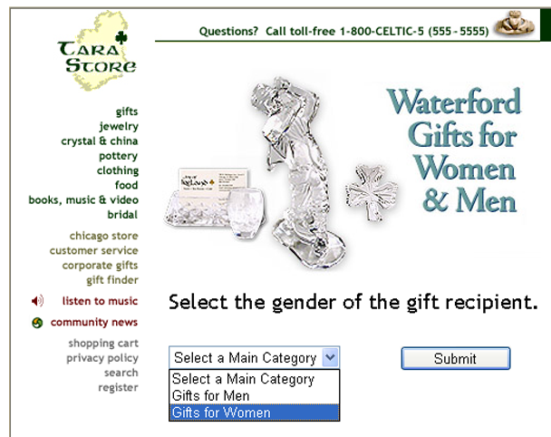
HTMLSelect.aspx
Click on dropdown list
  list and button disappear
  new image and new list appear
New list is based upon the choice selected from first dropdown list

Slide 27
HTMLSelect.aspx (PP. 105-107)
In the Page_Load event handler :
  If (Not IsPostBack) Then
  lblTitle.InnerHtml() = _
  "Select the gender of the gift recipient."
  imgProduct.Visible = False
  ProductList.Visible = False
  CatList.Items.Add("Gifts for Men")
  CatList.Items.Add("Gifts for Women")
  End If

Slide 28
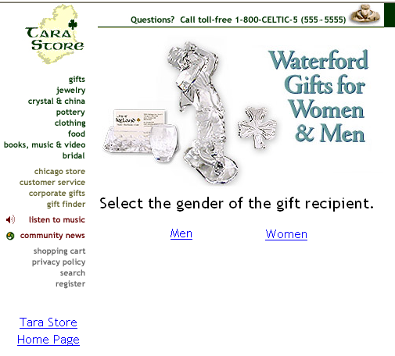
Creating a Page with a
Hyperlink Control
HTMLAnchor.aspx
  The hyperlink control creates an anchor tag
  Again, content is chosen based on which hyperlink was clicked

Slide 29
HTMLAnchor.aspx (PP. 107-108)
Change “Men” to a hyperlink in HTML view
    <A href="http://www.tarastore.com" id="AMale"
    name="AMale" runat="server">Men</A>
Change the URL with the HRef property in the code behind the page
    AMale.HRef = "GiftsForMen.aspx"
    AFemale.HRef = "GiftsForWomen.aspx"
    AHome.HRef = "http://www.tarastore.com"

Slide 30
Using ASP.NET
Web Form Controls
Also known as Web Controls
  Located on the Web Forms tab in the Toolbox
  Inherit from the Web Control class
ASP.NET controls can be logically grouped into:
  Web Form controls
  Rich controls
  Data controls
  Validation Controls
  Mobile Controls

Slide 31
Syntax Changes
Assigning Color Values
The color properties must be assigned using a different syntax
Color is a class - System.Drawing.Color
Assign the value - Known colors referred to by name
  MyControl.BorderColor = System.Drawing.Color.Green
Assign the value - from the text box or form
  MyControl.BackColor = Color.FromName(txtBackColor.Value)

Slide 32
DropDownList and Image Controls
Change the property of the Image control
  Image control class produces an <img> tag
    ImageURL - path to the image; creates the SRC property
    AlternateText – displays text when the image is not available; creates the ALT property
    ImageAlign - provides the image alignment; creates the align property
To capture mouse clicks, use ImageButton

Slide 33
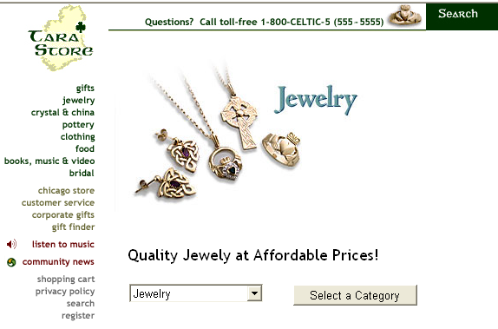
ASPSelect.aspx

Slide 34
ASPSelect.aspx (continued)
Add a drop-down list to a Web page, and dynamically add the options to the list when the page first loads
    If (Not IsPostBack) Then
      dlCategory.Items.Add("Gifts")
      dlCategory.Items.Add("Jewelry")
      dlCategory.Items.Add("China and Crystal")
      dlCategory.Items.Add("Pottery")
      dlCategory.Items.Add("Clothing")
      dlCategory.Items.Add("Food")
      dlCategory.Items.Add("Books, Music, and Video")
      dlCategory.Items.Add("Bridal")
    End If

Slide 35
ASPSelect.aspx (PP. 110-111)
In the submit button event handler
Get value and change the ImageURL property
    Select Case dlCategory.SelectedIndex
    Case 0
      lblTitle.Text = _
      "Let us help you find the best gift!"
      imgTop.ImageUrl = "images/21.jpg"

Slide 36
Panel and Literal Web Controls
The Panel control can contain other controls and creates a DIV tag to enclose the contents
  Set properties such as wrapping, absolute positioning, font type, and scrollbars
  Label control uses the SPAN tag
Literal control
  used to write content directly to the page

Slide 37

ASPPanel.aspx (PP. 111-112)

Slide 38
Placeholder and HyperLink
Web Controls
Placeholder control
  a container to store dynamically added server controls
  does not produce any visible output without the use of other controls
  dynamically create a hyperlink and literal control using constructors and add to the Controls collection

Slide 39
Placeholder and
HyperLink Web Controls (continued)
The HyperLink control
  Target - window or frame to load the Web page
    Default value is String.Empty
    Reserved windows are:
      _blank - renders in a new window without frames
      _parent - renders in the immediate frameset parent
      _self - renders in the frame with focus
      _top - renders in the full window without frames
    However, _New will also render in a new window

Slide 40
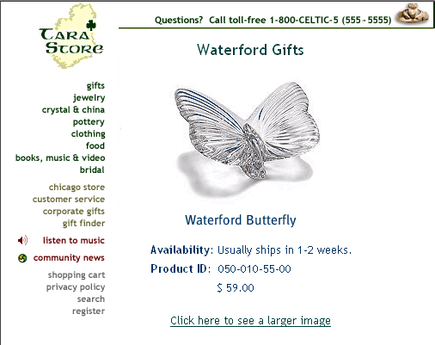
ASPPlaceholder.aspx

Slide 41
ASPPlaceholder.aspx (PP. 113-114)
Page_Load procedure
  ' Create a hyperlink
  Dim MyLink As New HyperLink
  placeholder.Controls.Add(MyLink)
  MyLink.Text = _
  "Click here to see a larger image"
  MyLink.ForeColor = _
  System.Drawing.Color.FromName("#004040")
  MyLink.Font.Name = "Trebuchet MS"
  MyLink.Font.Size = MyLabel.Font.Size.Smaller
  MyLink.ID = "HLHome"
  MyLink.NavigateUrl = "images/LgButterfly.jpg"
  MyLink.Target = "_new"

Slide 42
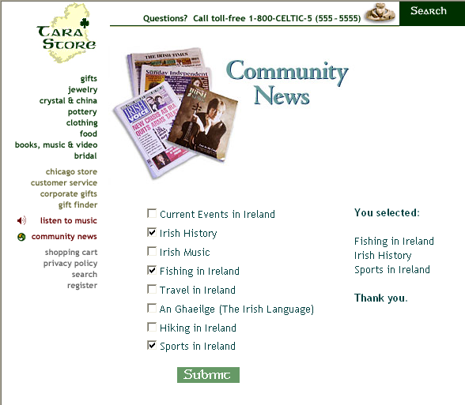
Working with CheckBoxes ASPCheckbox.aspx

Slide 43
Working with Checkboxes (PP. 114-115)
Retrieve values
  more than one value checked
  look at each checkbox
  Write the results to the string
  Dim MyMessage As String
  MyMessage = "<b>You selected:</b><br /><br />"
  If CB1.Checked Then
  MyMessage += CB1.Text & "<br />"
  End If

Slide 44
Using Validation Controls
Compare controls, or part of the controls such as the data, to a rule.
  Rule may require that the control contain any value, or require a specific form of data such as alphabetical or numeric.
  The rule may specify what the data must be contained within a range of two values.
  The rule may be very specific and require formatting such as uppercase letters and periods.

Slide 45
Using Validation Controls (continued)
The five validation controls are:
  RequiredFieldValidator – Makes sure a form field is not left blank
  RangeValidator – Makes sure a field’s value falls between a given range
  CompareValidator – Compares a field’s value with other values or other fields’ values
  RegularExpressionValidator – Evaluates data against a regular expression
  CustomValidator – Evaluates data against custom criteria

Slide 46
Using Validation Controls (continued)
Inherit from the BaseValidator class which inherits from the Label class
  Can display custom error messages using Labels
  ForeColor property
    error message color
    default is red
Validation controls that perform comparisons inherit from BaseCompareValidator base class

Slide 47
Using Validation Controls (continued)
Common properties and methods
  Display property - shows the message
    Dynamic - space for the validation message is dynamically added to the page if validation fails
    Static - space for the validation message is allocated in the page layout
    None - the validation message is never displayed in the browser

Slide 48
Using Validation Controls (continued)
Validate method performs validation on associated input control and updates the IsValid property
  IsValid indicates if the control is valid
  Page.Validate method and Page.IsValid property
Check if the entire page is valid
    Page.Validate()
    If Page.IsValid Then
    Message.Text = "Result: Valid!"
    Else
    Message.Text = "Result: Not valid!"
    End If
    End Sub

Slide 49
Using Validation Controls (continued)
ControlToValidate property specifies the control to validate
ValidationExpression property compares control to the regular expression
  Regular Expression
    is a rule that describes the value.
    language that describes one or more groups of characters.

Slide 50
Using Validation Controls (continued)
Visual Studio .NET
  built-in regular expressions
  Regular Expression Editor
  library of sample codes
    Internet E-Mail Address
    \w+([-+.]\w+)*@\w+([-.]\w+)*\.\w+([-.]\w+)*
    Internet URL
    http://([\w-]+\.)+[\w-]+(/[\w- ./?%&=]*)?
    US Zip Code
    \d{5}(-\d{4})?

Slide 51
Using Validation Controls (continued)
ValidationSummary control
  To summarize the error messages from all validators on a Web page, in one location
  DisplayMode – displays as a list (List), a bulleted list (BulletList), or a single paragraph (SingleParagraph)
  ShowSummary - shows the entire list ShowMessageBox - displays an alert box
  HeaderText - display a heading message

Slide 52
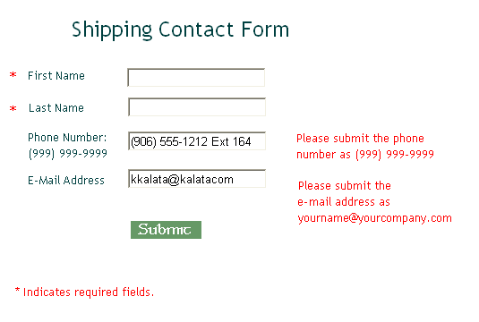
Validating Form Data ASPValidateForm.aspx

Slide 53
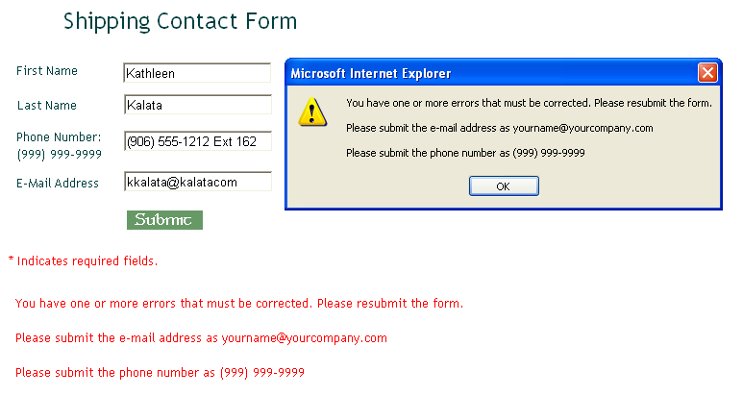
ASPValidationSummary.aspx
(PP. 119-121)

Slide 54
Binding to Simple Data
Bind data to controls
  Assign a DataSource
  Call the DataBind method
Group together controls
  RadioButtonList controls - group radio buttons
  CheckboxList controls - group CheckBox controls
Set group properties
  RepeatDirection property - displayed horizontally or vertically
  RepeatLayout property - use table or paragraph tags

Slide 55
Binding RadioButtonLists to ArrayLists
A type of array
  size dynamically increases as required
  declared using Dim, the array name, and keyword New
Properties and Methods
  Capacity - the number of items the list can hold
    zero-based - counting of items starts at 0 and not 1; default capacity of 16
  Count - determines the number of items in the list
  Add method - used to add items to the list
  SelectedItem - determines which element is selected

Slide 56
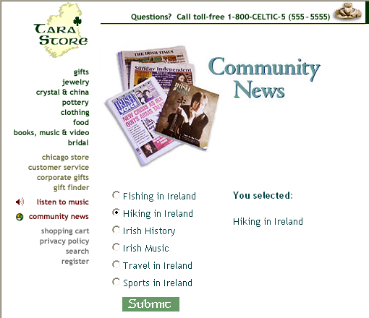
ASPDBRadioButtonList.aspx

Slide 57
ASPDBRadioButtonList.aspx (PP. 122-123)
Add items to array list and populate RadioButtonList
    AR1.Add("Sports in Ireland")
    RBL.DataSource = AR1
    RBL.DataBind()
Retrieve values in the submit button procedure
    Dim strResult As String
    strResult = "<b>You selected: </b><br/><br/>"
    If RBL.SelectedIndex > -1 Then
    strResult += RBL.SelectedItem.Text
    End If
    lblTopics.Text = strResult

Slide 58
Binding CheckBoxLists to HashTables
Items are added using a key and value pair
Declare - keyword Dim, HashTable name, keyword New
  Add method adds items to the HashTable.
  Use the key to retrieve the value for a particular item
You must specify the key and value:
  DataValueField is used to create the value
  DataTextField is used to create the text displayed

Slide 59
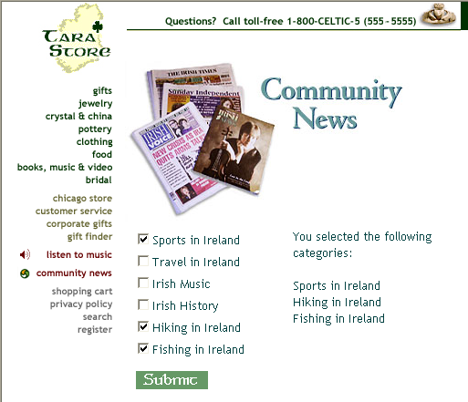
ASPDBCheckboxList.aspx

Slide 60
ASPDBCheckboxList.aspx (continued)
Add a value to a HashTable (key, value)
Populate the CheckBoxList and bind data to control
  Notice that you can display the key or value; value displayed:
    If Not Page.IsPostBack Then
      Dim HS1 As New HashTable(9)
      HS1.Add(5, "Sports in Ireland")
      CBL.DataSource = HS1
      CBL.DataTextField = "Value"
      CBL.DataValueField = "Key"
      CBL.DataBind()
    End If

Slide 61
ASPDBCheckboxList.aspx (PP. 124-125)
Loop through each control in the list - read the Selected property
    Dim strResult As String
    If CBL.SelectedIndex > -1 Then
    strResult = _
    "You selected the following categories:<br /><br />"
    Dim i As Integer
    For i = 0 To CBL.Items.Count - 1
    If CBL.Items(i).Selected Then
    strResult += CBL.Items(i).Text + "<br />"
    End If
    Next
    Else
    strResult = "You did not select a category."
    End If
    lblTopics.Text = strResult

Slide 62
Summary
HTML Server controls are HTML controls where runat = “server”
Can change Server control properties in the Properties window or in the code behind the page
ASP.NET controls (Web controls) provide more controls with additional properties and methods
  CheckBoxList and RadioButtonList controls – group controls within a single control
  HyperLink – creates a text or image hyperlink

Slide 63
Summary (continued)
ASP.NET controls (Web controls) provide more controls with additional properties and methods (continued)
  Panel – can contain other controls
  Placeholder – used to store dynamically created controls
Validation controls
  assign rules to validate form fields
  can create custom rules

Slide 64
Summary (continued)
Can dynamically populate some Server controls with data using ArrayLists and HashTables

